Slide 1


ELPIS Spirit of hope
NAME : Medhovarsh Bayyapureddi
GRADE : 10
SCHOOL: Sri Chaitanya School, Vijayawada, INDIA
This Photo by Unknown author is licensed under CC BY-SA-NC.

Slide 2
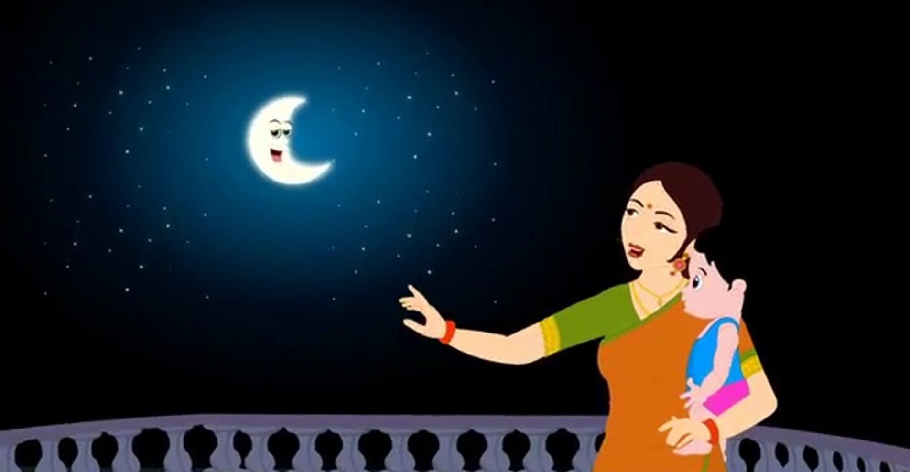
Every mother in India shows the beautiful night sky and sings for her baby inadvertently setting high standards for the child to reach for the moon and the stars. Thus, starts a journey of a child to explore his or her dreams of adventure.

Slide 3


NEED FOR A SPACE SETTLEMENT
Imagine an event of a natural or a man-made calamity which may endanger the very existence of life on the earth…
We need a Noah’s Ark to save the human race – A Space Settlement is the last resort as a temporary abode for the survival of the humans.
I present my project ‘ELPIS’ (The Greek spirit of hope). To make space as an inspiration to mankind we designed ELPIS, which holds the key to the future of humans.
ELPIS a space settlement program which is a permanent home or habitation for human beings in a pre-set location of space.

Slide 4

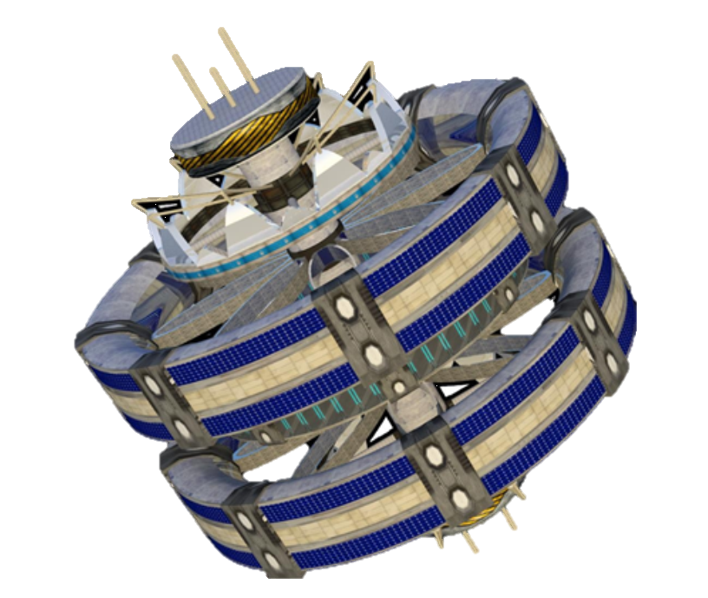
ELPIS
STRUCTURAL OVERVIEW
UPPER ANTENNA
UPPER DOCKING SECTION
UPPER INDUSTRIAL RING
UPPER RESIDENTIAL TORUS
AGRICULTURAL TORUS
LOWER RESIDENTIAL TORUS
LOWER INDUSTRIAL RING
LOWER DOCKING SECTION

Slide 5

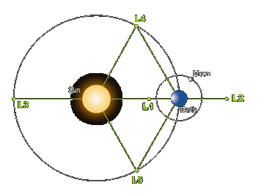
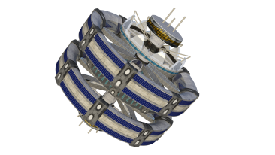
ELPIS
LOCATION: L4

Slide 6
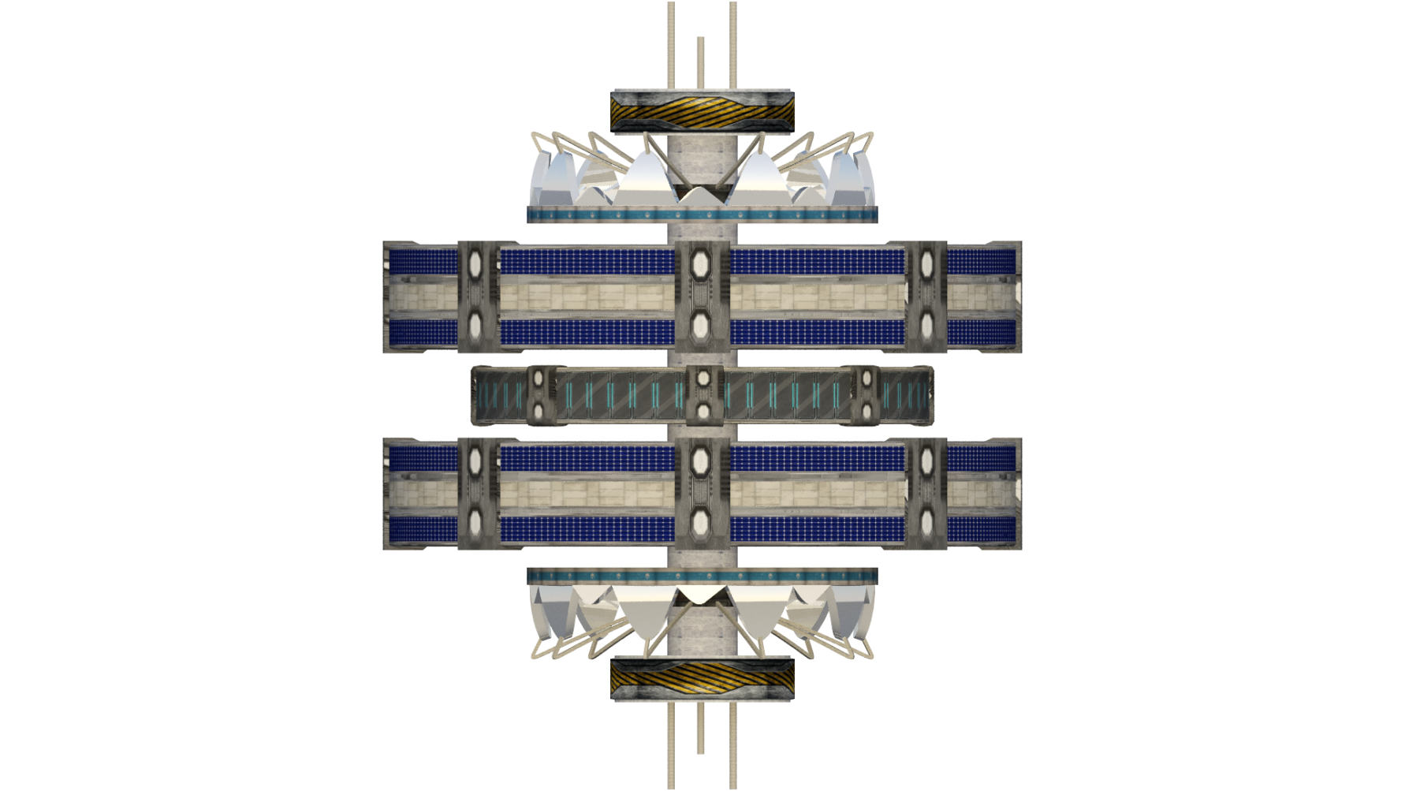
ELPIS
LATERAL VIEW

Slide 7
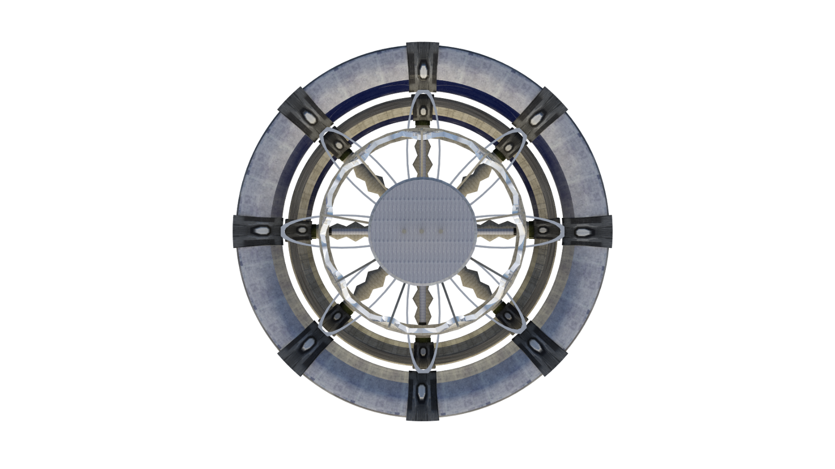
ELPIS
TOP VIEW

Slide 8
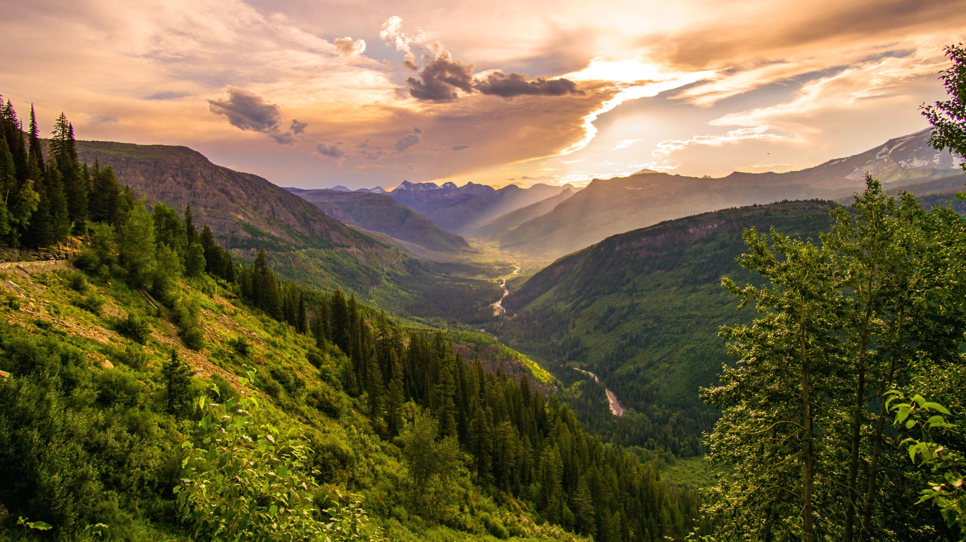
LIFE SUPPORT
In ELPIS gravity is generated using pseudo gravity.
Atmosphere created in ELPIS is similar to the Earth.
Agriculture is mainly PRACTICED using methods such as hydro culture system and aeroponics in ELPIS.
Recycling methods followed in ELPIS using Eco-digesters and converting waste to usable fuels.
Water is produced using Sabieter's reaction: CO2 + 4H2→CH4 + 2H2O
Electricity is produced using solar photovolataic cells.
The protection of ELPIS is done by Electromagnetic shield surroundING the colony.

Slide 9

OPERATIONS AND AUTOMATIONS
In ELPIS, the vehicles used for transportation are same as on earth but modified , eco-friendly and modernized.
In ELPIS we use DSN( Deep Space Network) and laser communication system .
The core of any successful society is only formed through quality education. Schools in the ELPIS provide good foundation for the future of the children .

Slide 10


HUMAN LIFE DESIGN
In ELPIS we have planned parks, restaurants etc. for relaxation.
Maintaining proper health is highly essential. So, ELPIS is equipped with modern hospitals and advanced diagnostic and treatment facilities.
For the maintenance of the space settlement, ELPIS will have Cleaning Group, Edifice Group, Machinery & Automobile Group, Automated Structural Group, Outer Space Group and Transportation Group.
The constitution of our settlement will follow democracy, equality and fraternity (brotherhood). Every single person on ELPIS shall be given equal rights and honour.
This Photo by Unknown author is licensed under CC BY-SA.
This Photo by Unknown author is licensed under CC BY-SA.

Slide 11


RESEARCH AND INDUSTRIES
Research helps in sustainance of life in the space and helps in improving the conditions for humans. All the research labs are provided with sophisticated equipment. Even the required conditions like temperature, gravity are also optimally maintained.
Industries play a vital role in development of conditions for human beings. In ELPIS various kinds of industries are present that are eco–friendly and make work and life easier for the mankind.
This Photo by Unknown author is licensed under CC BY.
This Photo by Unknown author is licensed under CC BY-SA.

Slide 12
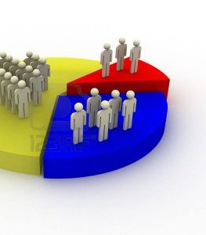
AGE DEMOGRAPHY
AGE GROUP | NUMBER OF MALES | NUMBER OF FEMALES | TOTAL NUMBER OF PEOPLE
CHILDREN ( 0 - 12) | 1,600 | 1,600 | 3,200
TEENAGERS (13 –20) | 2,000 | 2,000 | 4,000
ADULTS (21 – 50) | 4,500 | 4,500 | 9,000
OLD PEOPLE (51 – 90) | 1,500 | 1,500 | 3,000
VISITORS | 1,400 | 1,400 | 2,800
TOTAL | 11,000 | 11,000 | 22,000
This Photo by Unknown author is licensed under CC BY.

Slide 13
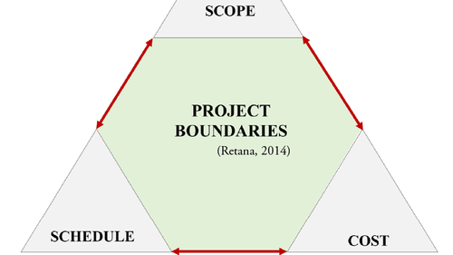

COST AND SCHEDULE
TOTAL COST OF CONSTRUCTION OF ELPIS:
$112,876,236,908
TIME TAKEN FOR CONSTRUCTION OF ELPIS:
45 YEARS
Construction of Elpis is expected to start in the year 2055 and completed by the year 2100.
This Photo by Unknown author is licensed under CC BY-SA-NC.

Slide 14

CONCLUSION
Next time when you look at the stars, remember you can reach them.
Keep dreaming …
Sincere thanks to all the sources of images and information for which I could not find the authors and owners.

